Slide 1
Inferring sensitivity and specificity of phenotyping algorithms using positive and negative predictive value in validation study
Mingkai Peng
September, 2018

Slide 2
Back ground:
What is the phenotyping in the observational data?
Specifications for identifying patients or populations with a given characteristic or condition of interest from EHRs using data that are routinely collected in EHRs or for administrative purposes.
Type of phenotyping algorithms:
Rule based: list of diagnosis code, combination of drug, lab, or diagnosis codes
Probabilistic based: logistic regression, machine learning

Slide 3
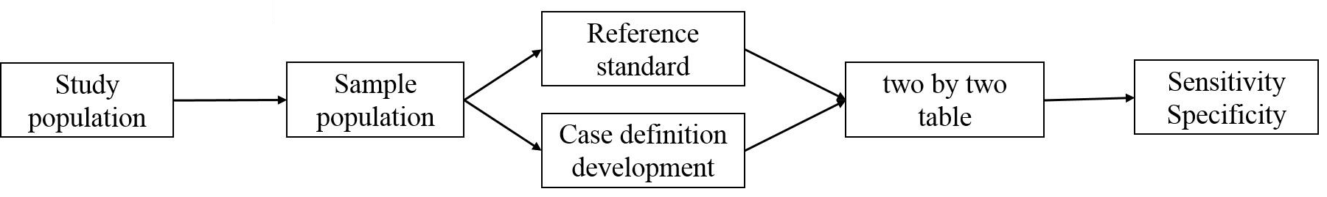
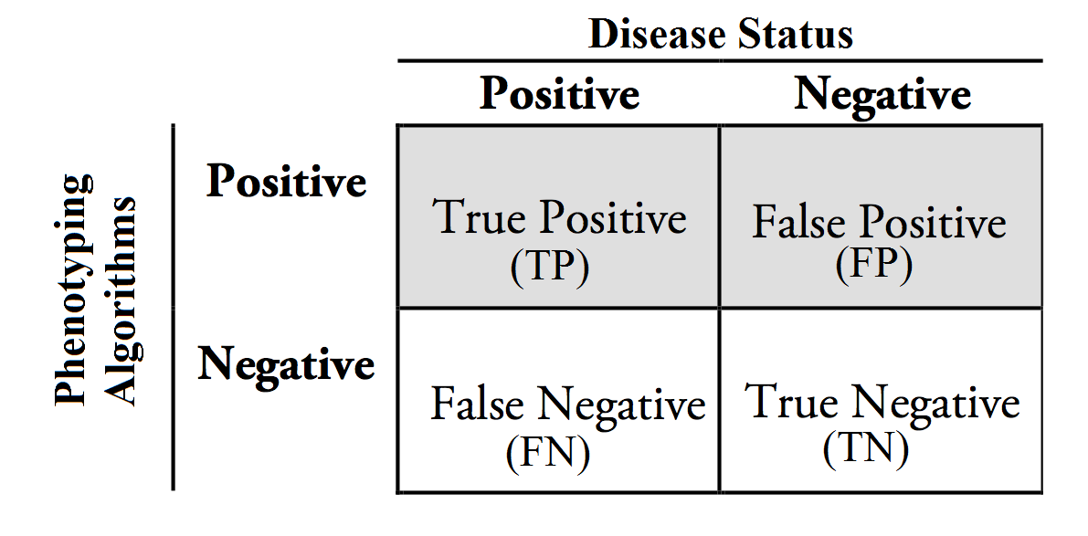
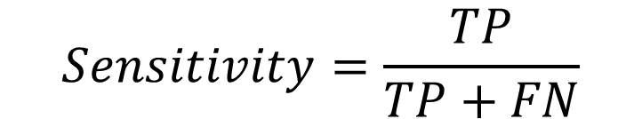
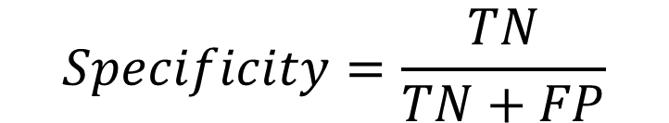
Validation study - Direct Method
$$Sensitivity=\frac{TP}{TP+FN}$$
$$Specificity=\frac{TN}{TN+FP}$$

Slide 4
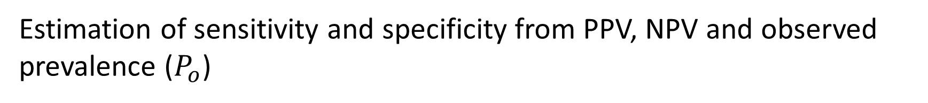
Validation study – Indirect method
Estimation of sensitivity and specificity from PPV, NPV and observed prevalence ($P_{o}$)
Sampling proportion of positive (SPP): the number of sampled positives divided by the total sample size in a study
Notes:
Observation prevalence: Proportion of positives defined by the phenotyping algorithm

Slide 5
Simulation - 1:
Study population:
The size of population: 50000
Sample size in validation study: 200, 500;
True disease prevalence: 0.05, 0.02, 0.01, 0.005
Phenotyping algorithm:
Sensitivity: 0.25, 0.5, 0.75
Specificity: 0.98
For indirect method:
SPP: 10%, 30%, 50%

Slide 6
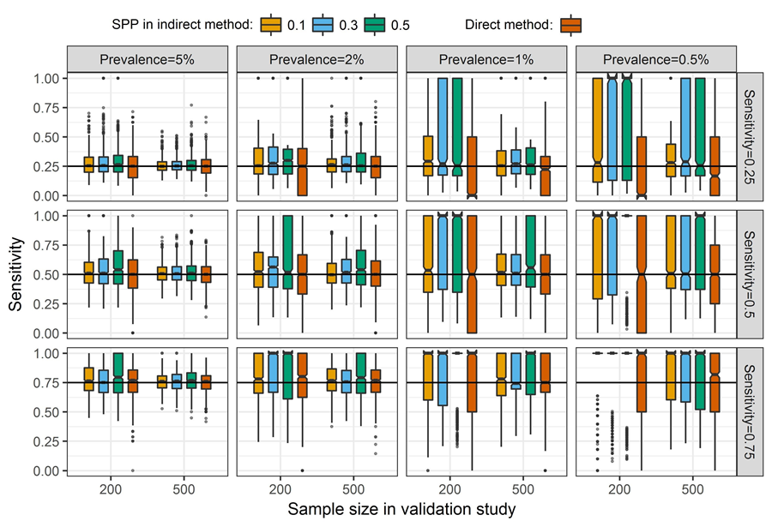
Sensitivity:
Notes:
IQR is smaller than

Slide 7
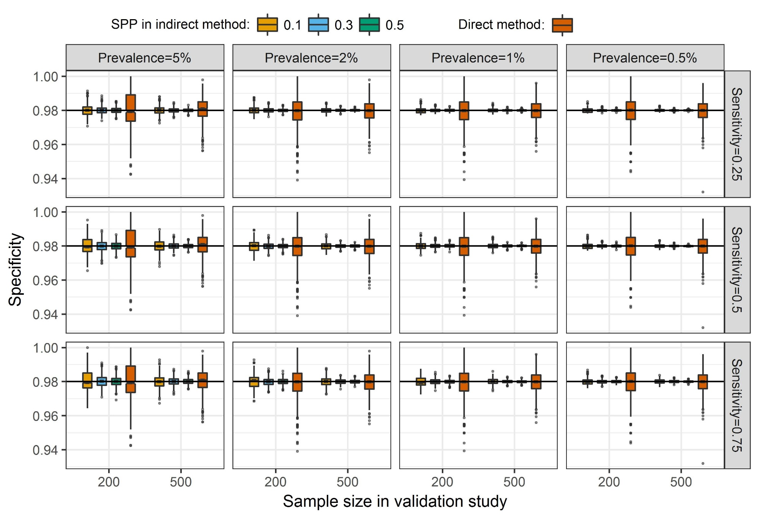
Specificity:

Slide 8
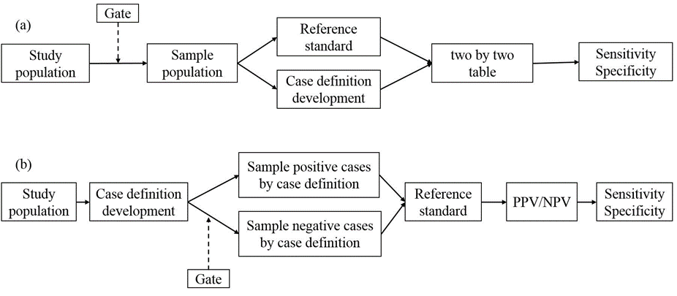
Gate in the validation study
Direct
Method:
Indirect
Method:
Gate: a list of criterions to exclude the non-cases (or very very low chance to have the conditions) in the study population
Proportion excluded (PE): the number of excluded individuals divided by the total number of individual in a database.

Slide 9
Simulation - 2 :
Study population:
The size of population: 50000
Study sample size: 500;
True disease prevalence: 0.01, 0.005, 0.002, 0.001
Phenotyping algorithm:
Sensitivity: 0.25, 0.5, 0.75
Specificity: 0.98
For indirect method:
SPP: 10%, 30%,
PE: 40%, 60%, 80%
The study repeated for 1000 times.

Slide 10
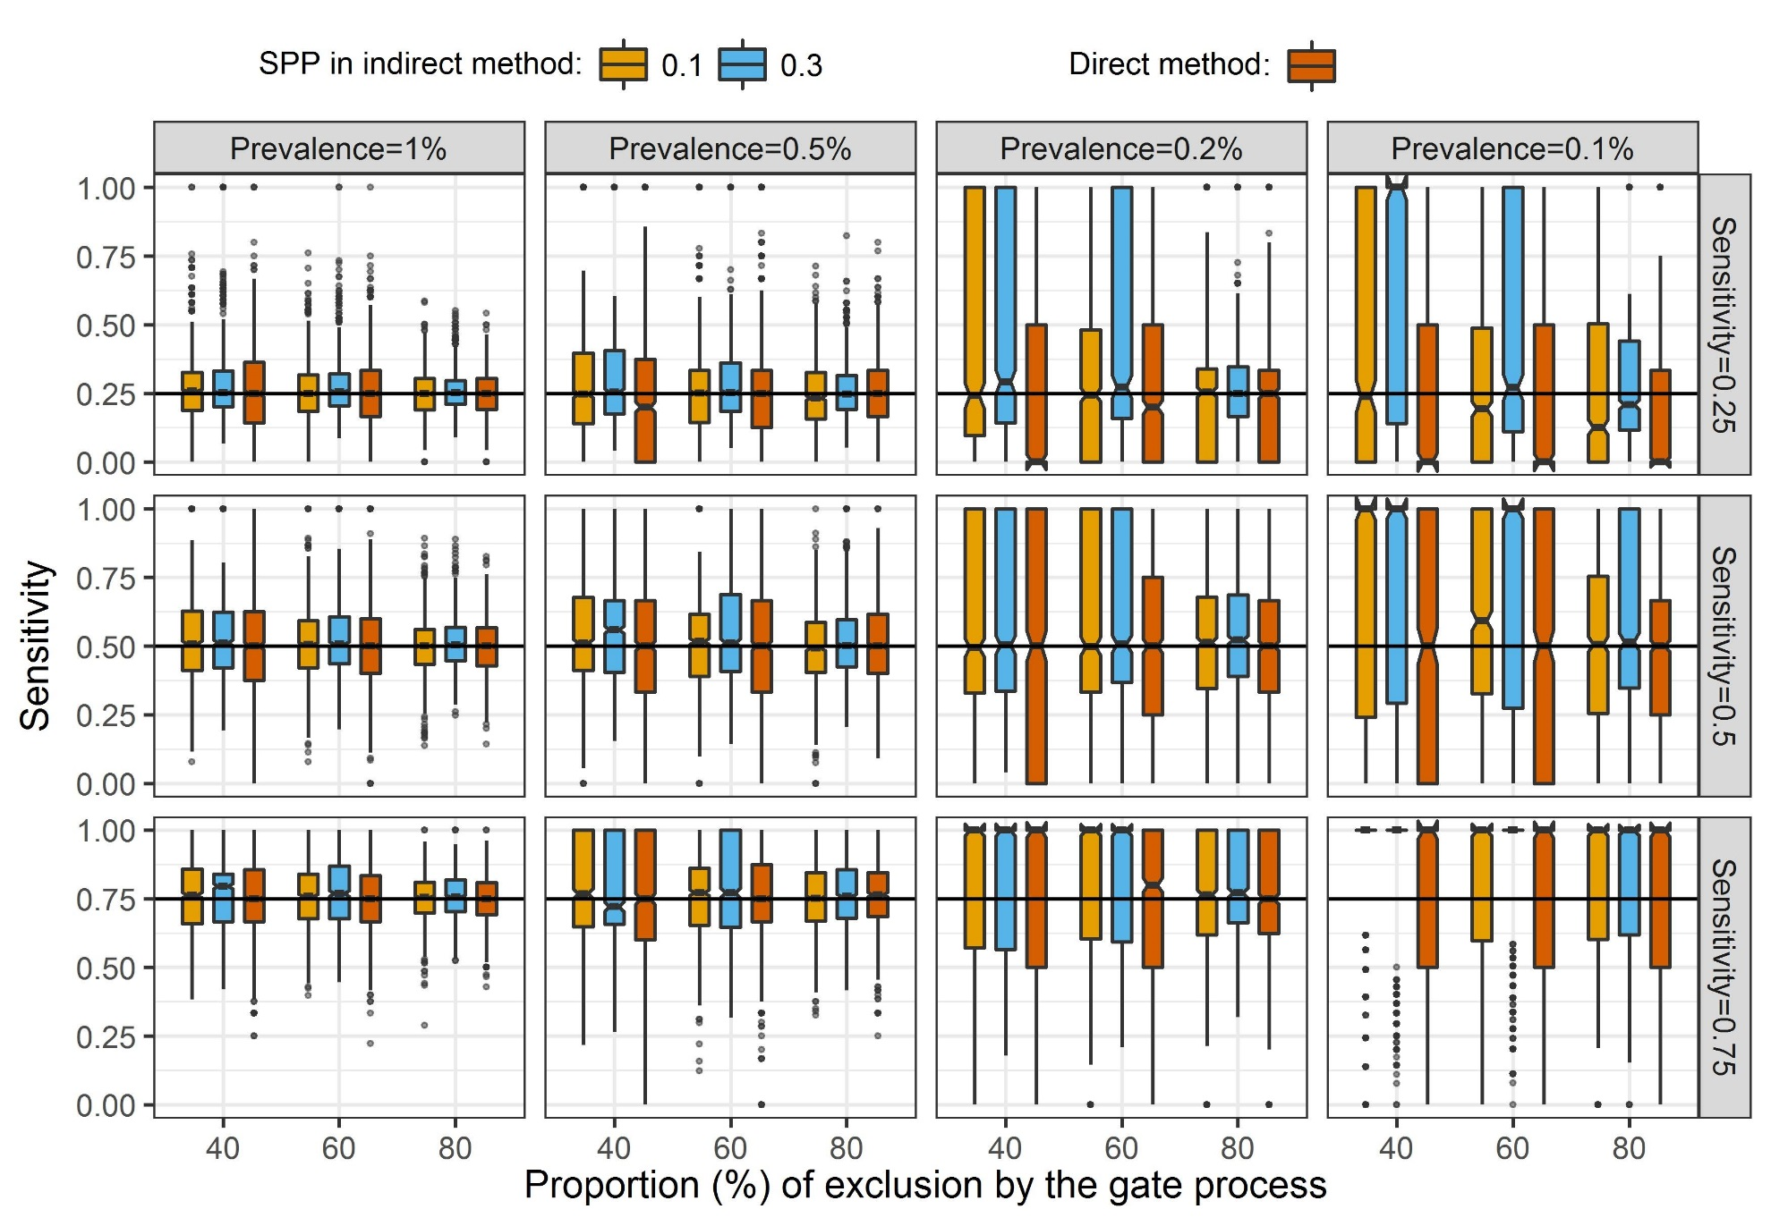
Sensitivity – With Gate

Slide 11
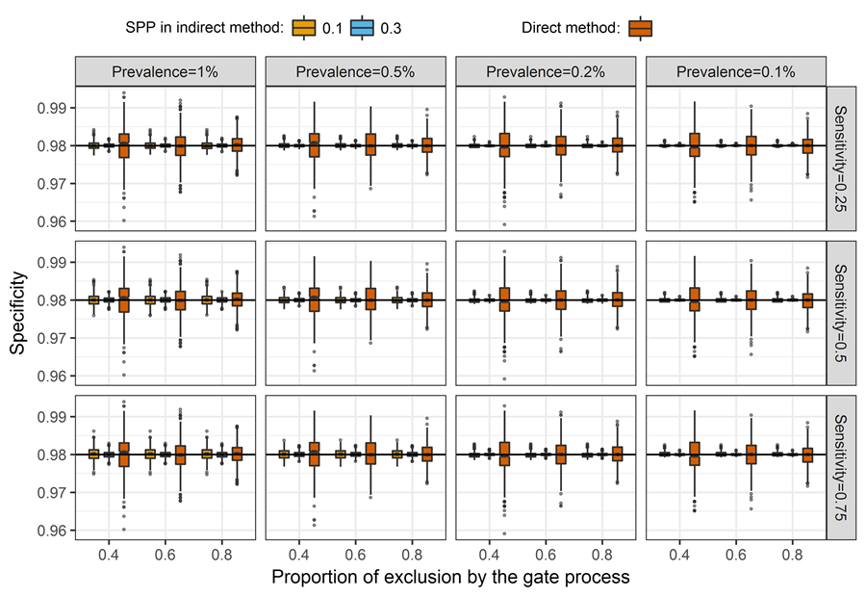
Specificity – With Gate
Notes:
Figure 5. Empirical assessment of direct and indirect methods in estimating specificity at different levels of disease prevalence and study sample sizes for algorithm sensitivities of 0.25, 0.5, and 0.75. The SPP for the indirect method is at 0.1 and 0.3.

Slide 12
Sensitivity analysis on the imperfect gate
Proportion of false negatives being excluded: the number of false negatives being excluded divided by the total number of false negatives. Set the values at 10%, 20%, 30%
Notes:
A gate is imperfect if it also excluded some false negatives.

Slide 13
Sensitivity = 0.5, specificity = 0.98

Slide 14
Conclusion:
We proposed an alternative way to conduct validation study.
The indirect method provides better or comparable accuracy in estimating both sensitivity and specificity compared to the traditional direct method.
Applying a gate to exclude true negatives is an effective way to improve estimation accuracy when the disease prevalence is low.

Slide 15


Slide 19
Validation study is a process to construct the two by two table.

Slide 21
Sensitivity, specificity, PPV, and NPV

Slide 22
Methods
Direct
Method:
Indirect
Method:

Slide 23
Simulation:
Sensitivity: 0.25, 0.5, and 0.75;
Specificity: 0.98;
Prevalence of the target condition: 0.001, 0.002, 0.005, 0.01, 0.02, and 0.05;
Sample size in validation study: 200 and 500

Slide 25
Sensitivity:

Slide 26
Specificity:

Slide 27
Including a Gate in the Validation Study:
Gate: a screening process to exclude individuals with extremely low chance to have the target condition before the sampling process.
Direct
Method:
Indirect
Method:

Slide 28
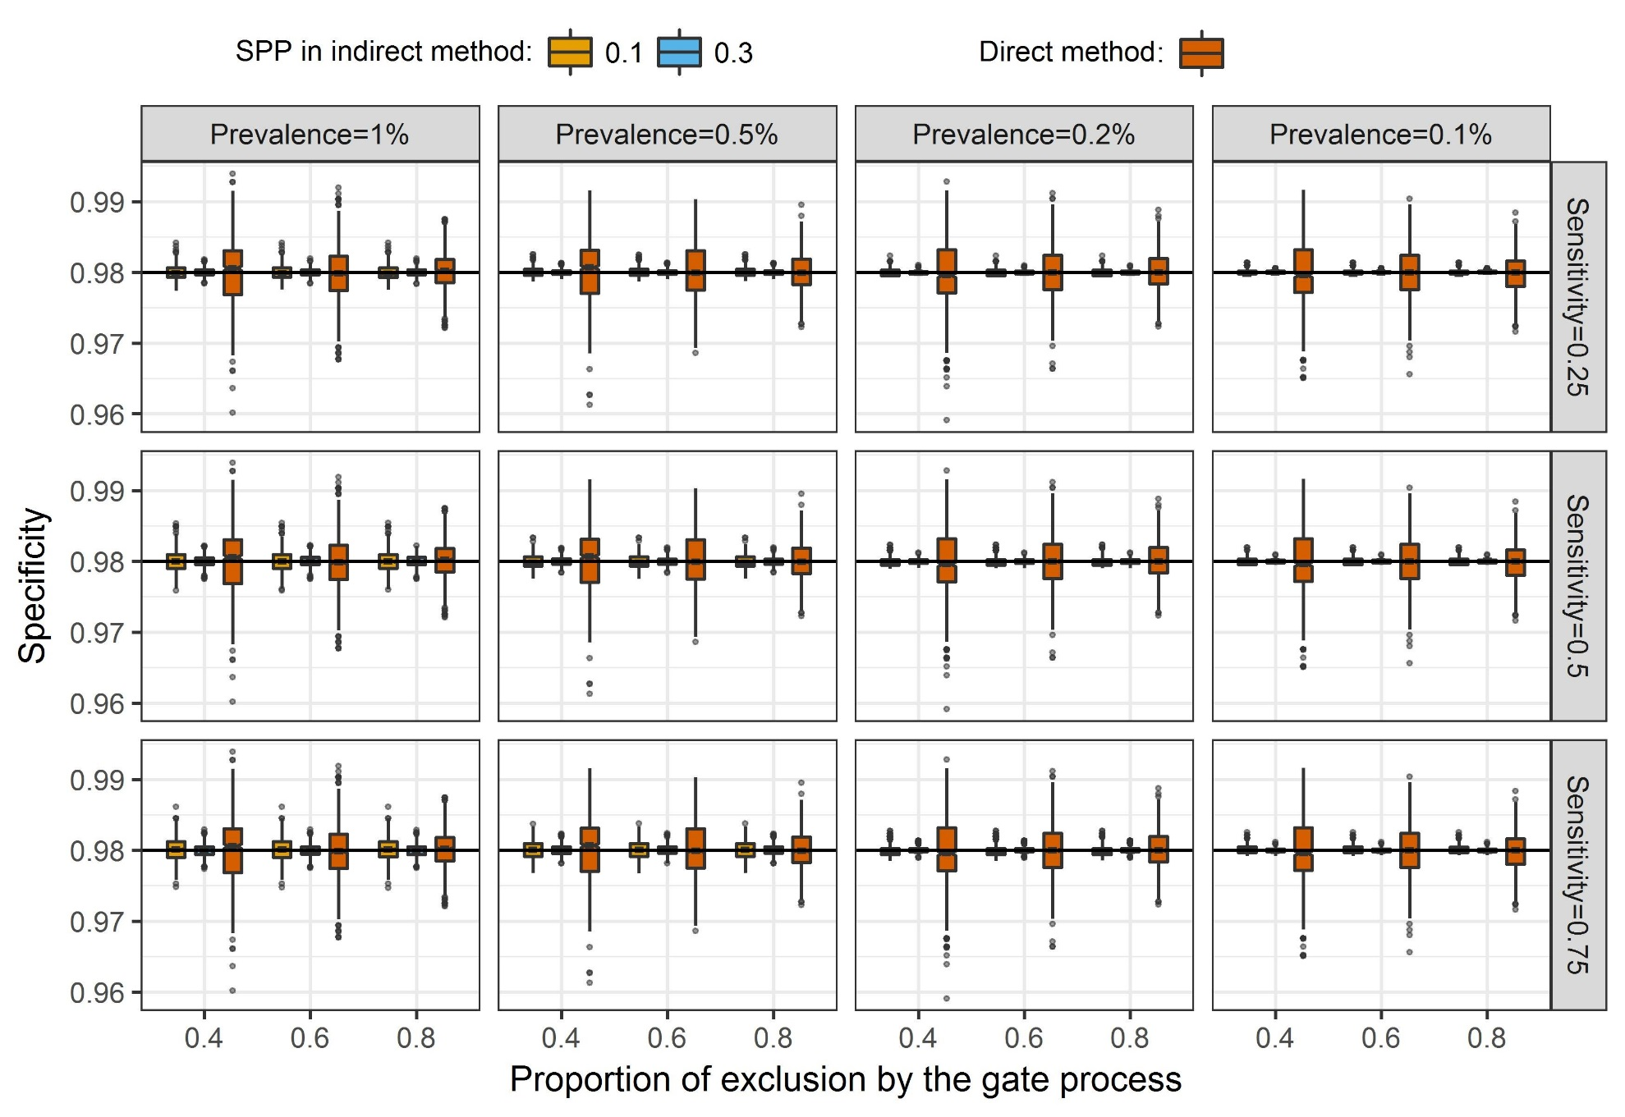
Sensitivity – With Gate

Slide 29
Specificity – With Gate
Notes:
Figure 5. Empirical assessment of direct and indirect methods in estimating specificity at different levels of disease prevalence and study sample sizes for algorithm sensitivities of 0.25, 0.5, and 0.75. The SPP for the indirect method is at 0.1 and 0.3.

Slide 30
Conclusions
We proposed a new method to validate phenotyping algorithms by inferring sensitivity and specificity from PPV, NPV.
The proposed method allow for adjusting the number of positive and negative cases

